Slide 1
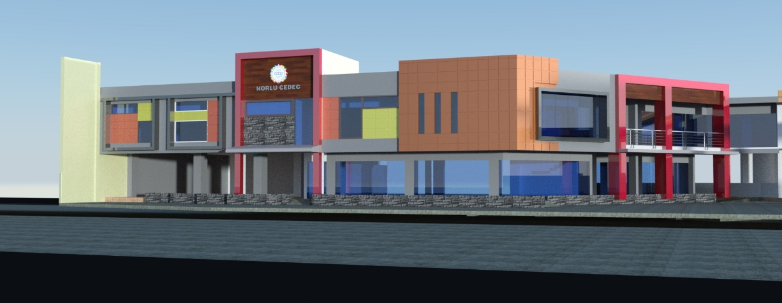
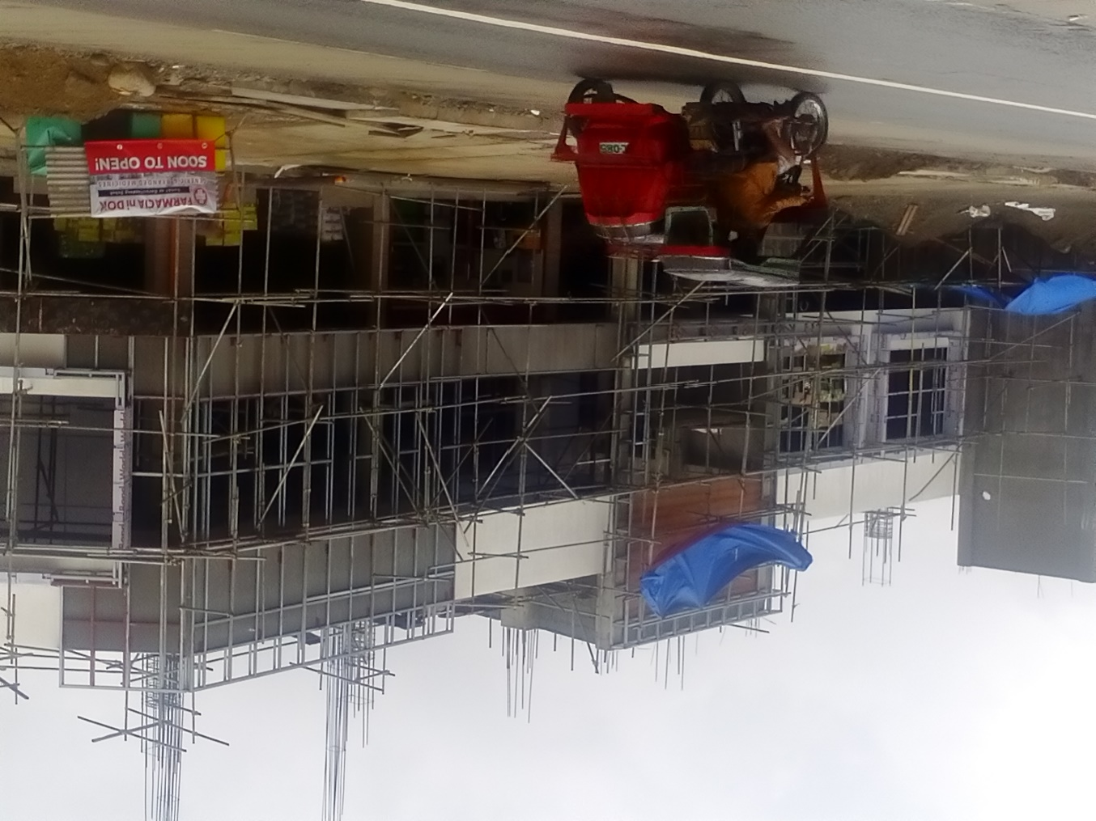
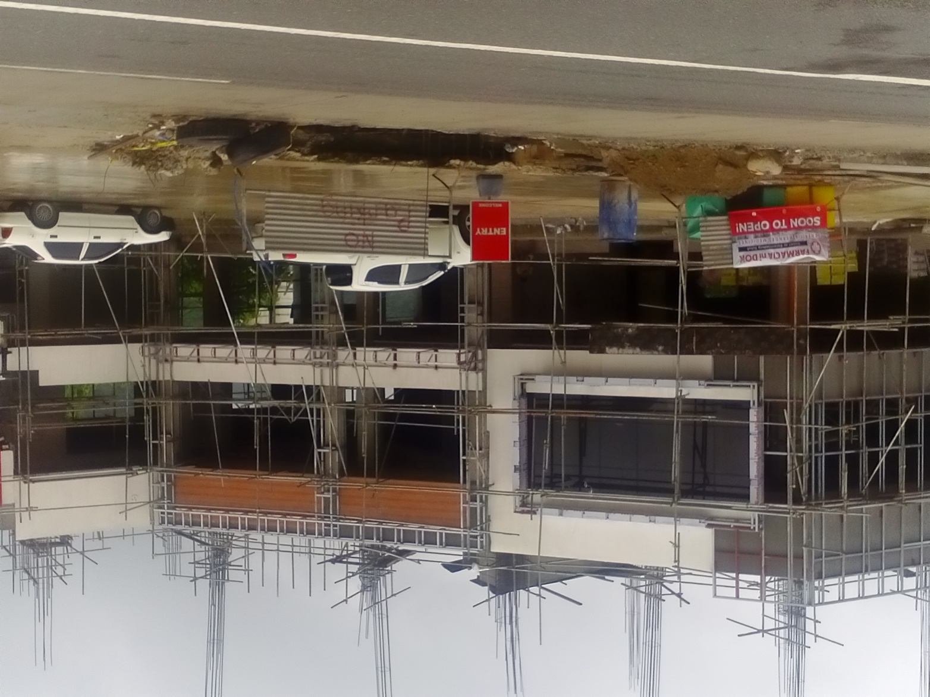
THE FAÇADE
READY FOR PAINTING
AND CLADDING COMPLETION

Slide 2

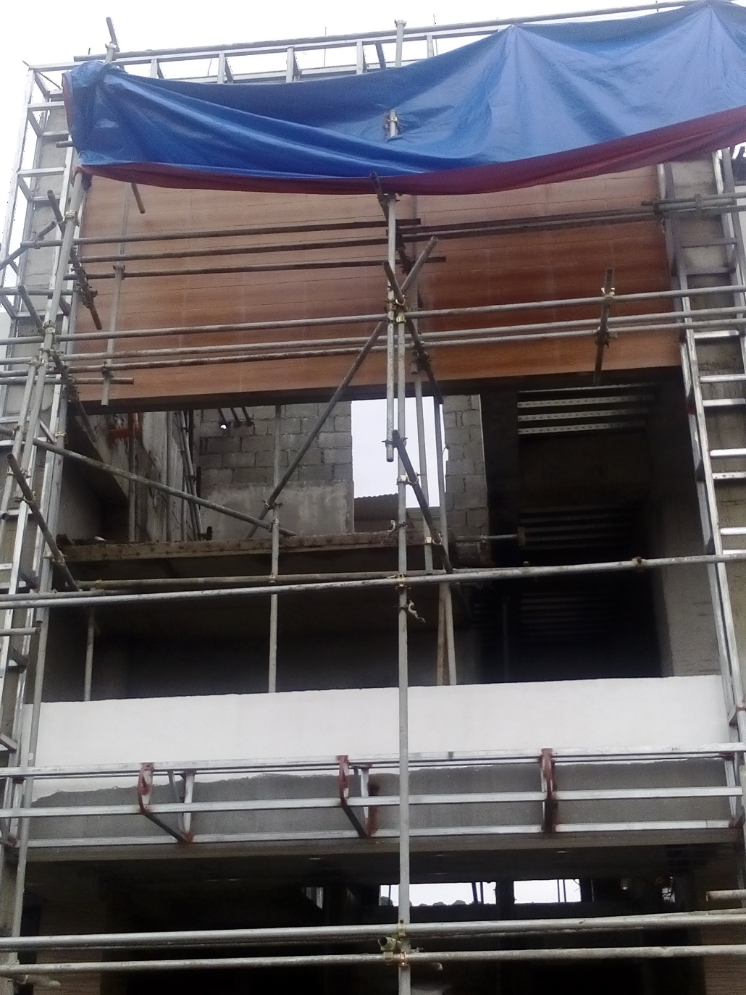
THE LOGO
THE ACTUAL SPACE FOR LOGO

Slide 3
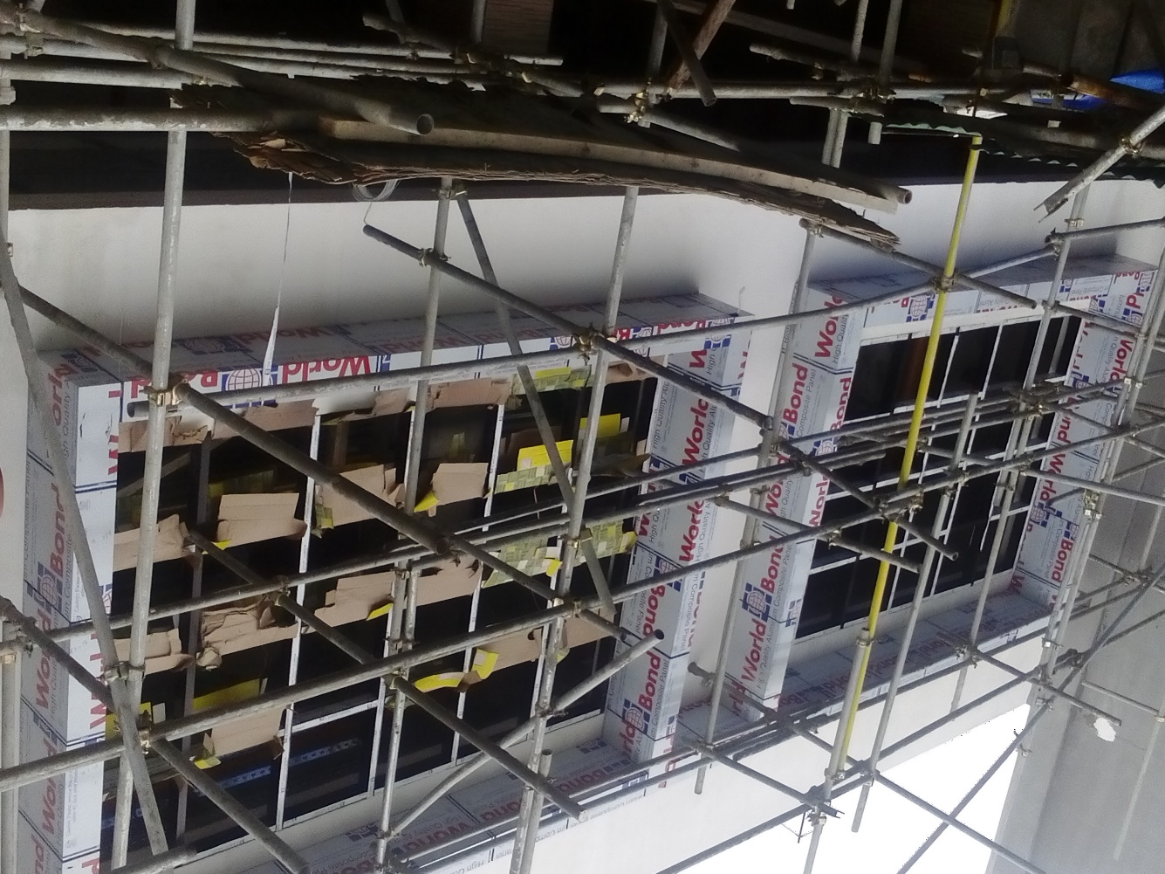
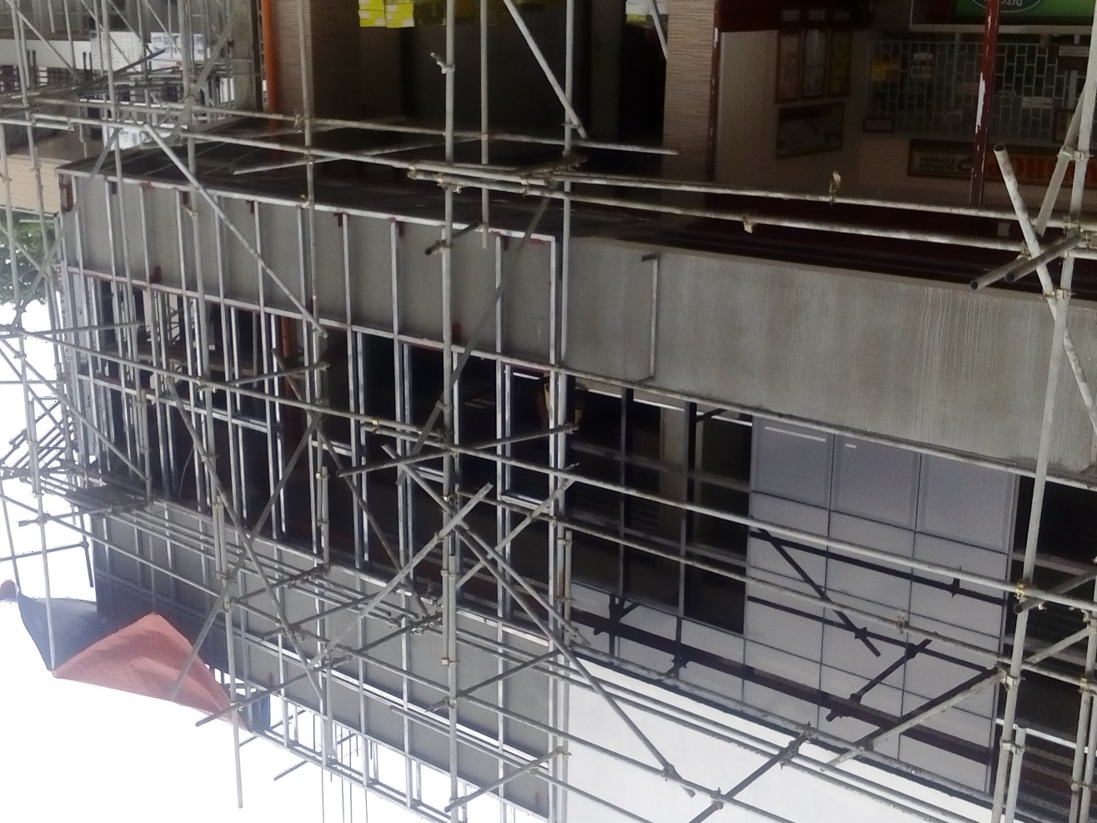
CLADDING ELEMENT AT FAR LEFT OF FAÇADE
COMPLETED
CLADDING SPACE AT MIDPART OF FAÇADE
READY FOR INSTALLATION

Slide 4
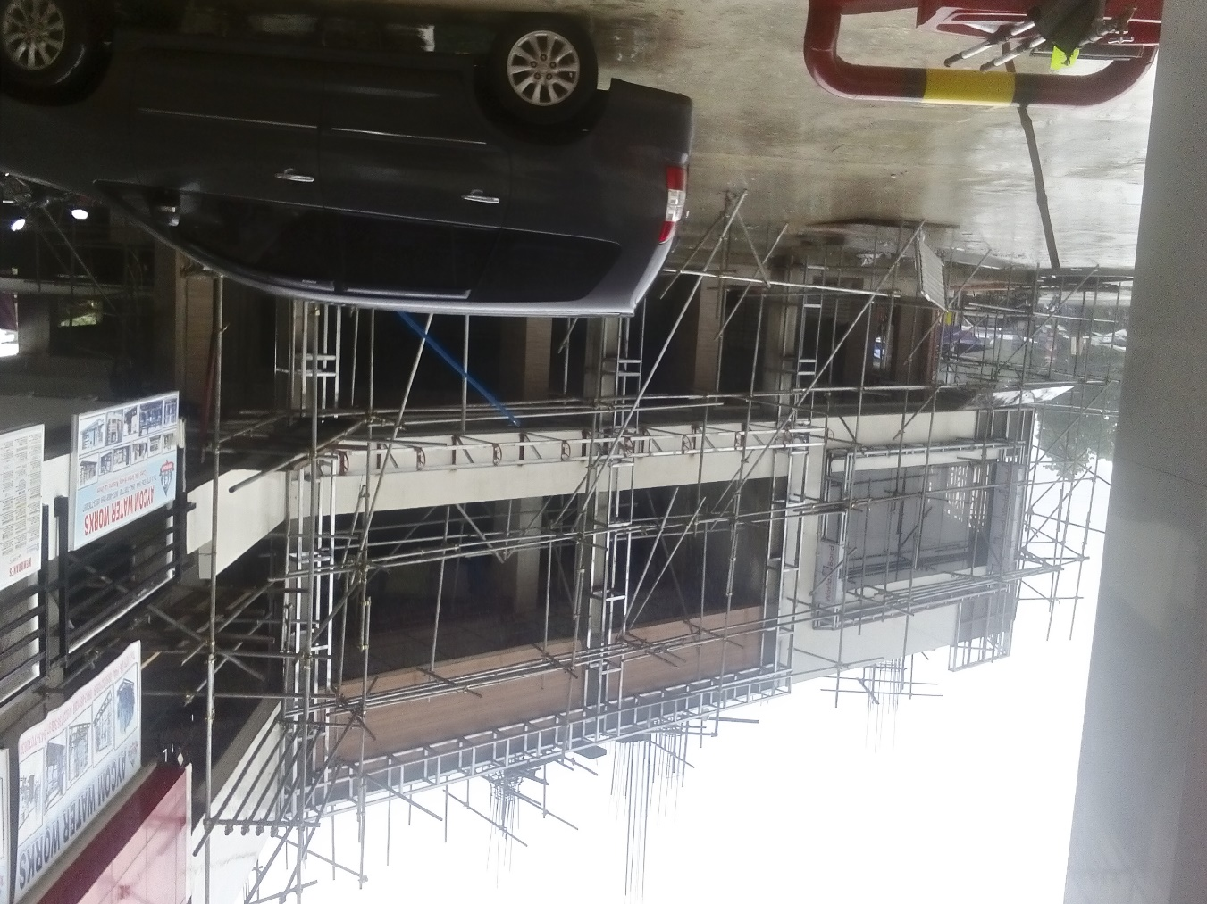
CLADDING OC FAÇADE FACING GAS STATION
ONGOING INSTALLATION

Slide 5
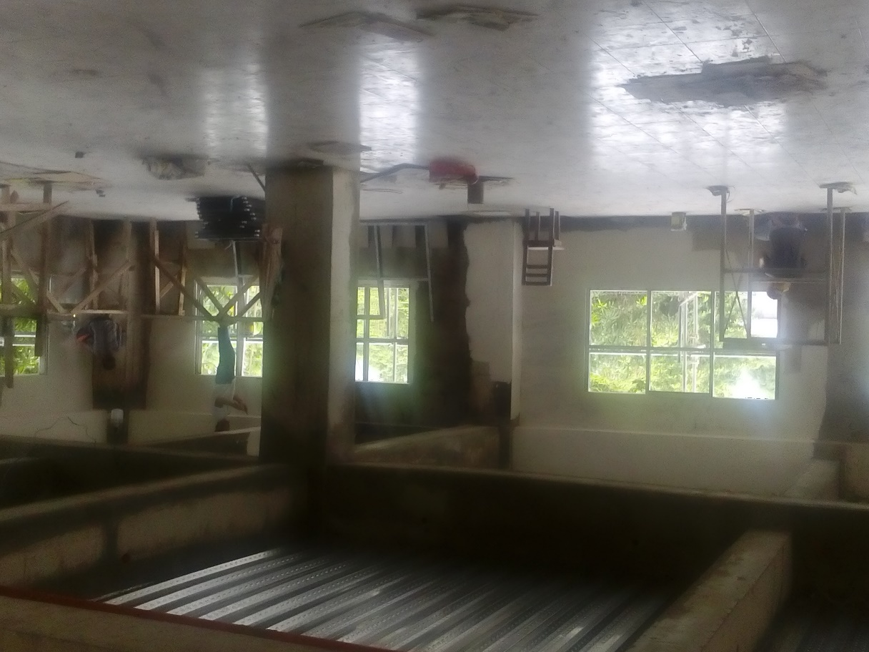
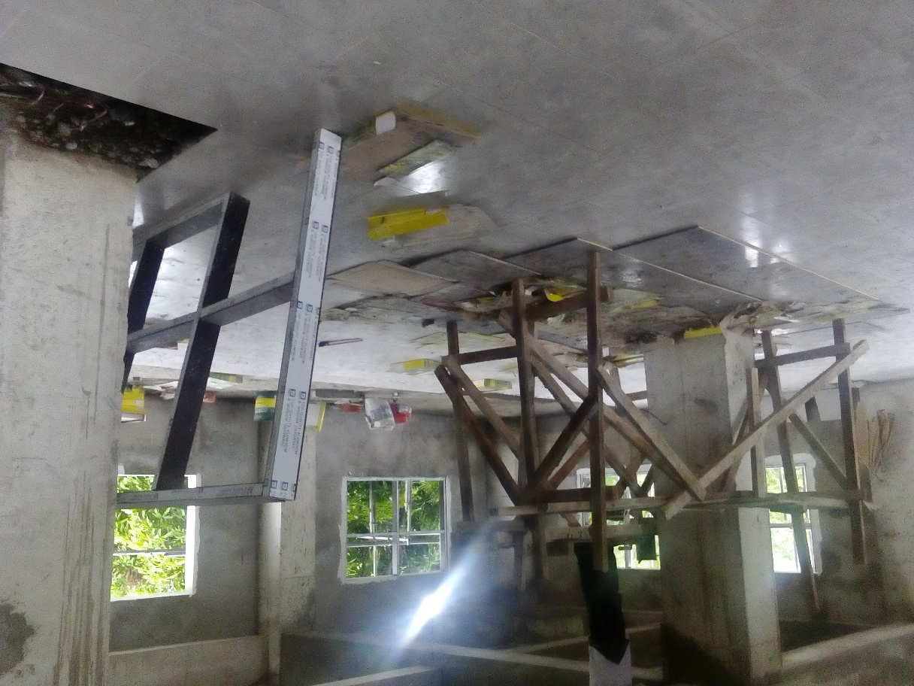
TILEWORKS AT SECOND FLOOR
LEFT SIDE AREAS

Slide 6
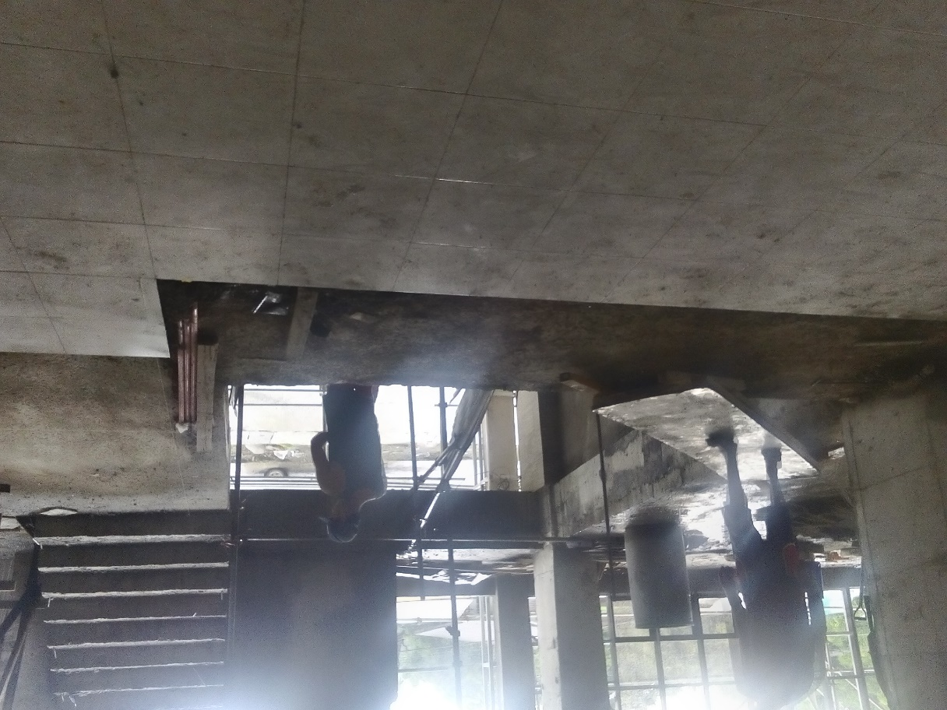
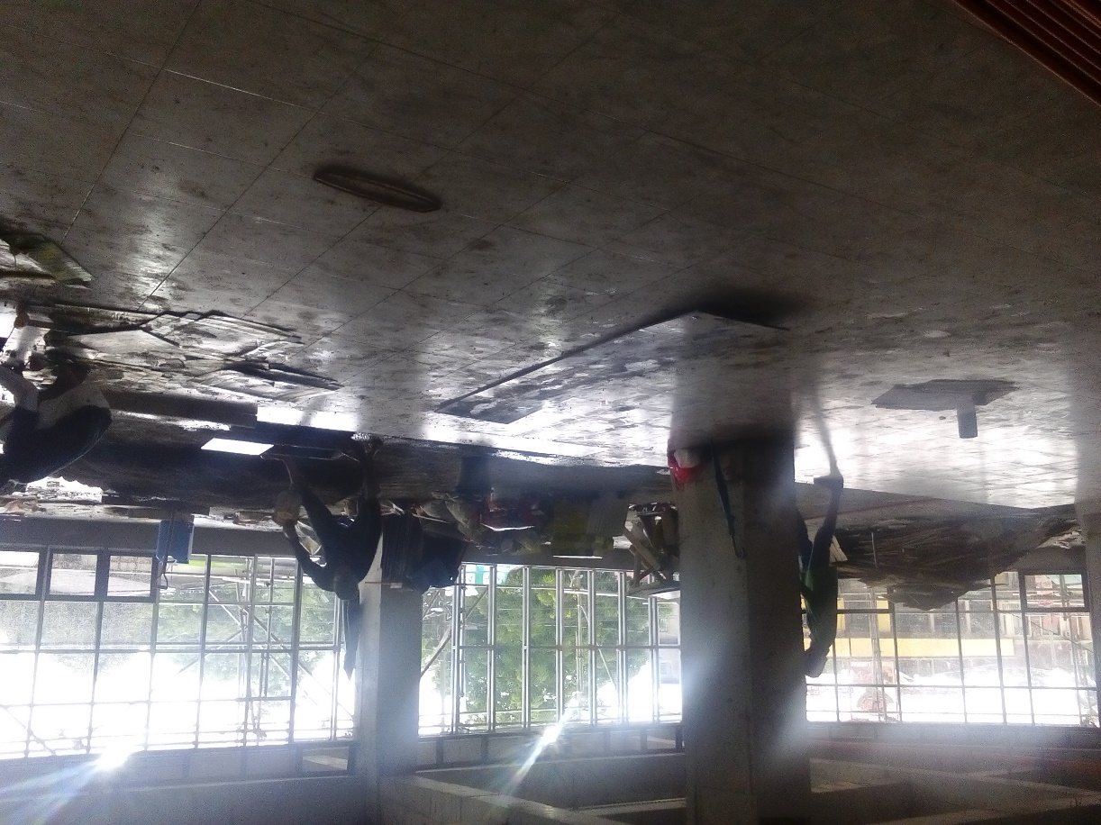
TILE WORKS AT SECOND FLOOR
INFRONT OF MAIN ENTRANCE STAIR CASE
RIGHT SIDE AREA

Slide 7
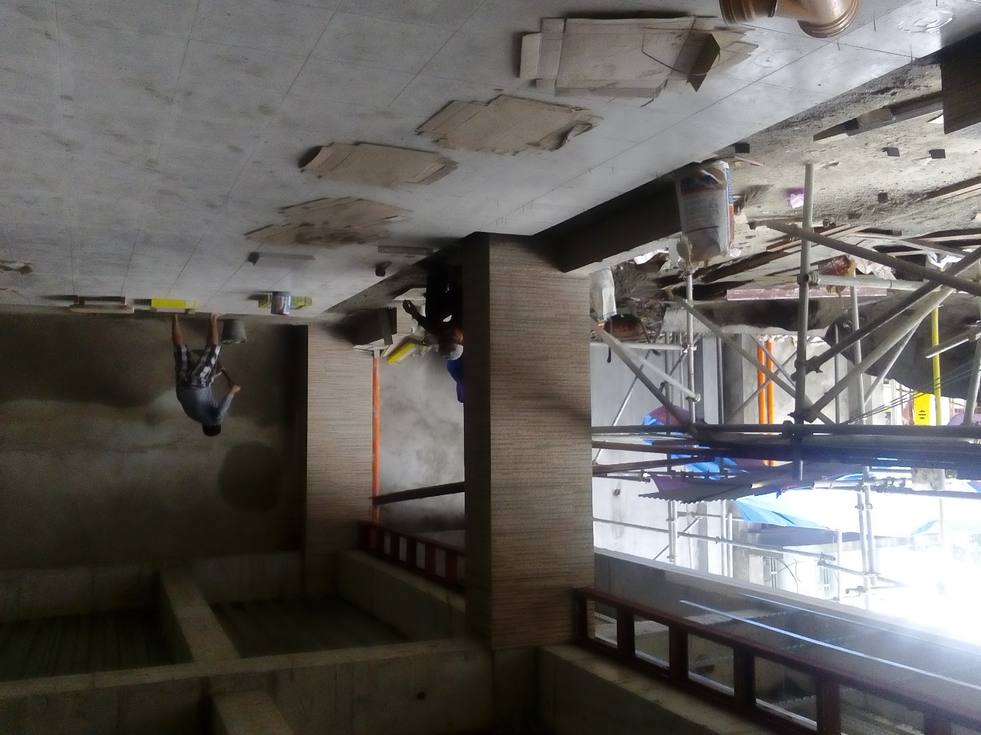
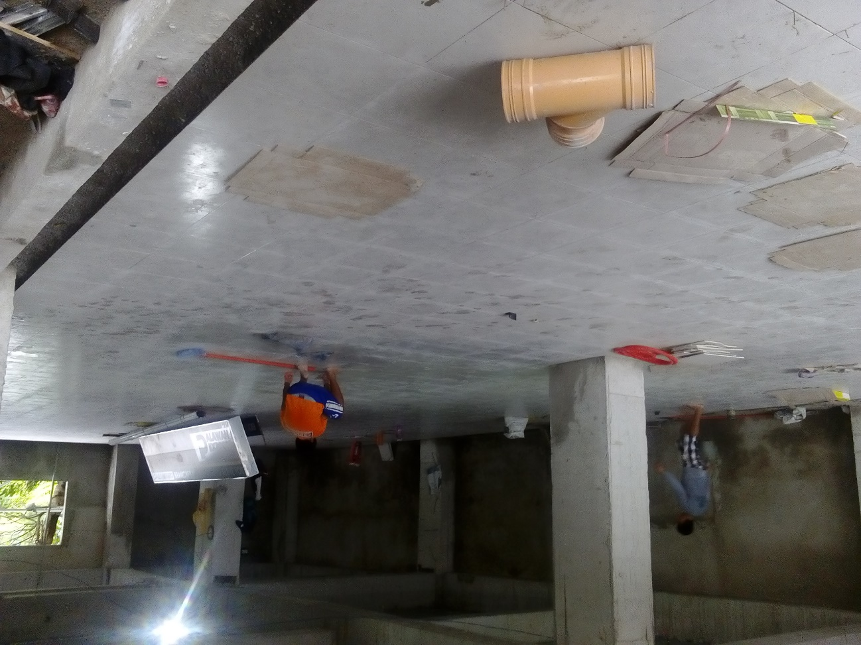
TILE WORKS AT FIRST FLOOR
TILE WORK FOR HONDA MOTORCYCLES SPACE AT FIRST FLOOR

Slide 8
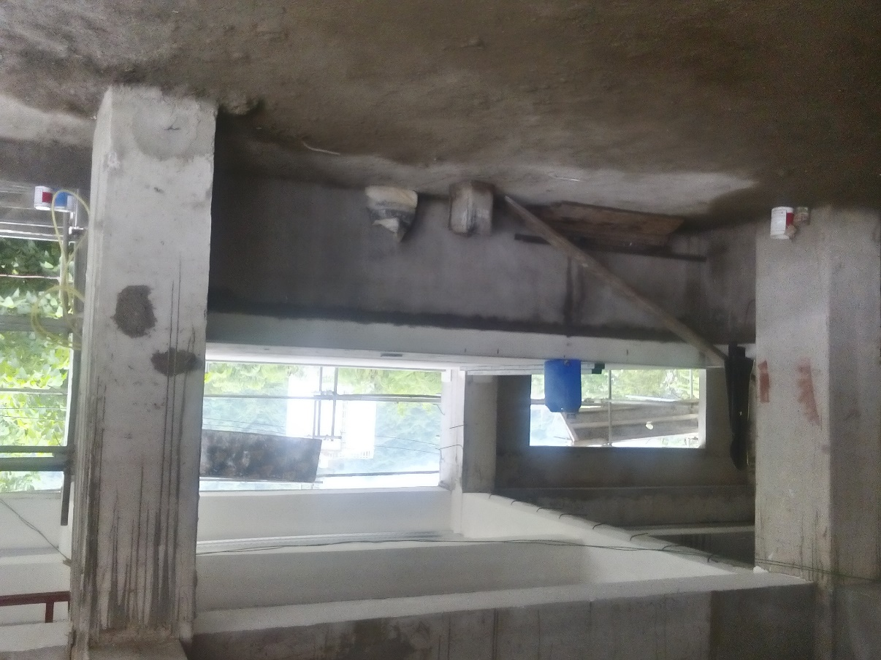
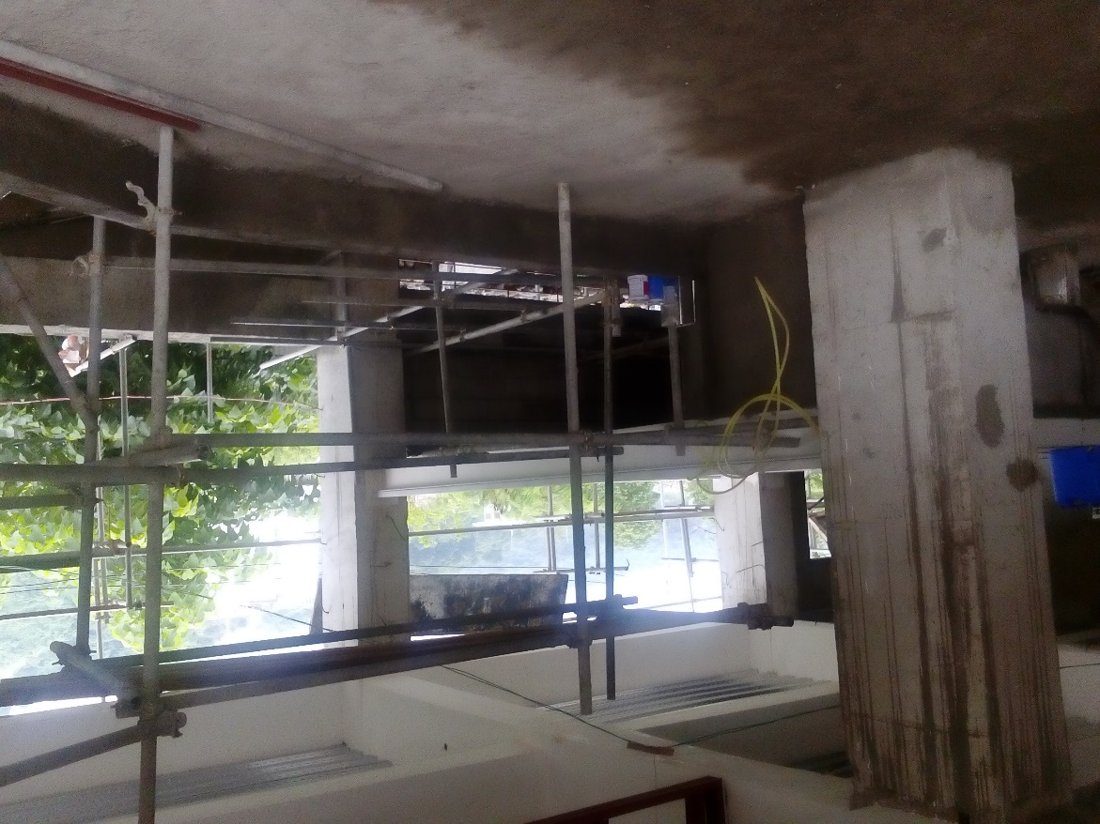
ADDITIONAL MEZZANINE FLOOR AT FIRST FLOOR
FOR 88 CONSUMER COOP SPACE
READY FOR TILE WORKS

Slide 9
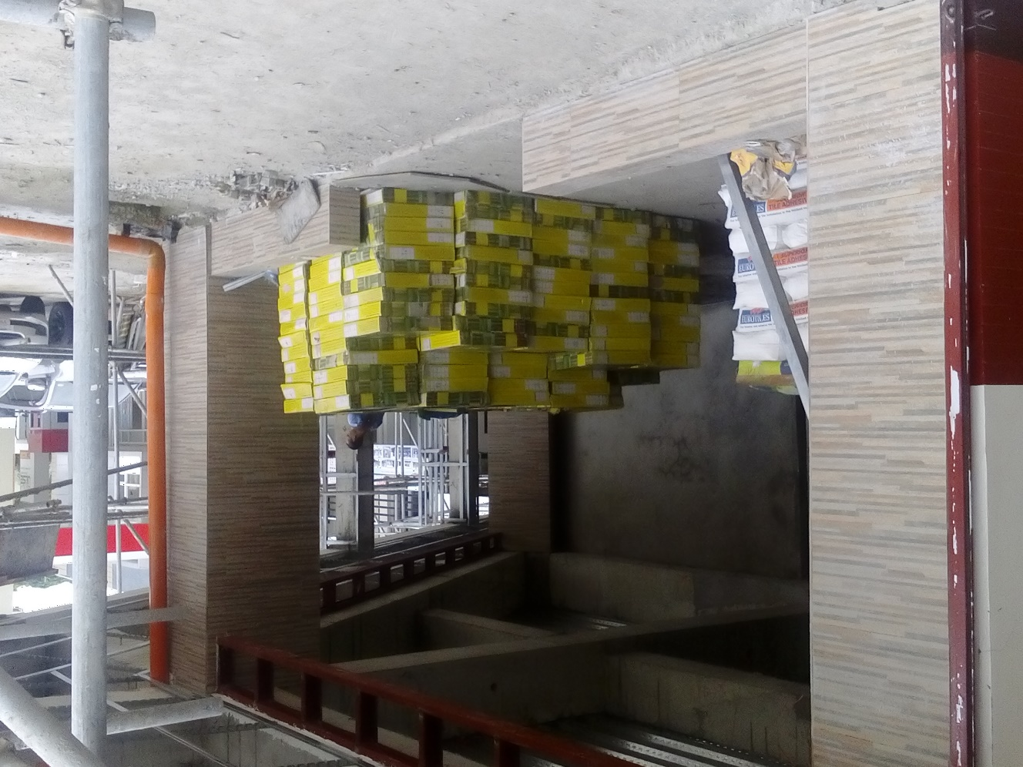
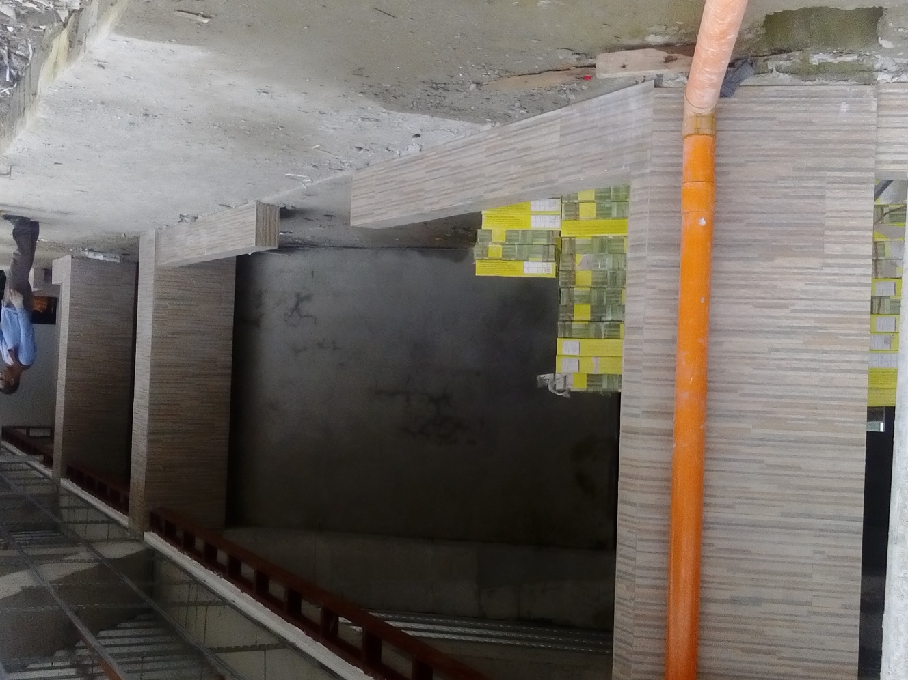
THE FRONTAGE OF THE PROPOSED KUMPARES SPACE AT FIRST FLOOR
READY FOR FLOOR TILEWORKS

